Slide 1
Portfolio Data Analytics with Global Fishing Watch
Exploring Fishing Activity in Member Countries of the Sub-Regional Fisheries Commission (CSRP/SRFC) and the Fisheries Committee for the West Central Gulf of Guinea (CPCO/FCWC)
Presented by
Ndeye Coumba BOUSSO
Scientific Researcher (UCAD/ESP)
Thanks to Global Fishing Watch.
Thanks to the instructors of Google Data Analytics Professional Certificate.
This analysis was supported by conversational AI tools to improve conceptualization, code review, and data storytelling. All analysis, decisions, and interpretations were my own.

Slide 2
General Question
How Does Fishing Activity Vary in Member Countries of the Sub-Regional Fisheries Commission (CSRP/SRFC) and the Fisheries Committee for the West Central Gulf of Guinea (CPCO/FCWC) According to Key Parameters?
Parameters analyzed:
Year and Month
Flag State
Gear Type
Marine Protected Area
Time period considered: 2020–2024
CSRP/SRFC member states: Senegal, Mauritania, The Gambia, Guinea-Bissau, Guinea, Sierra Leone, and Cabo Verde CPCO/FCWC member states: Benin, Côte d’Ivoire, Ghana, Liberia, Nigeria, and Togo

Slide 3
Specific Questions
How does the total number of fishing hours vary by year and by fleet type (local vs. foreign) in the areas covered by the CSRP and the CPCO? How does this variation look for each individual CSRP and CPCO member country?
Which are the top five flag states with the highest total fishing hours in the CSRP and CPCO regions? Which are the top five flag states in each individual CSRP and CPCO member country?
How does the total number of fishing hours vary by gear type in the CSRP and CPCO regions? What are the five most commonly used fishing gear types in each CSRP and CPCO country?
What are the top five most used fishing gear types by the top five flag states with the highest total fishing hours in the CSRP and CPCO regions?
How does the total number of fishing hours vary by month in the CSRP and CPCO regions? How does this monthly variation appear for each CSRP and CPCO country?
How do fishing hours using trawler gear vary by month in each CSRP and CPCO country?
What are the total fishing hours recorded within Marine Protected Areas (MPAs) in the CSRP and CPCO regions?

Slide 4
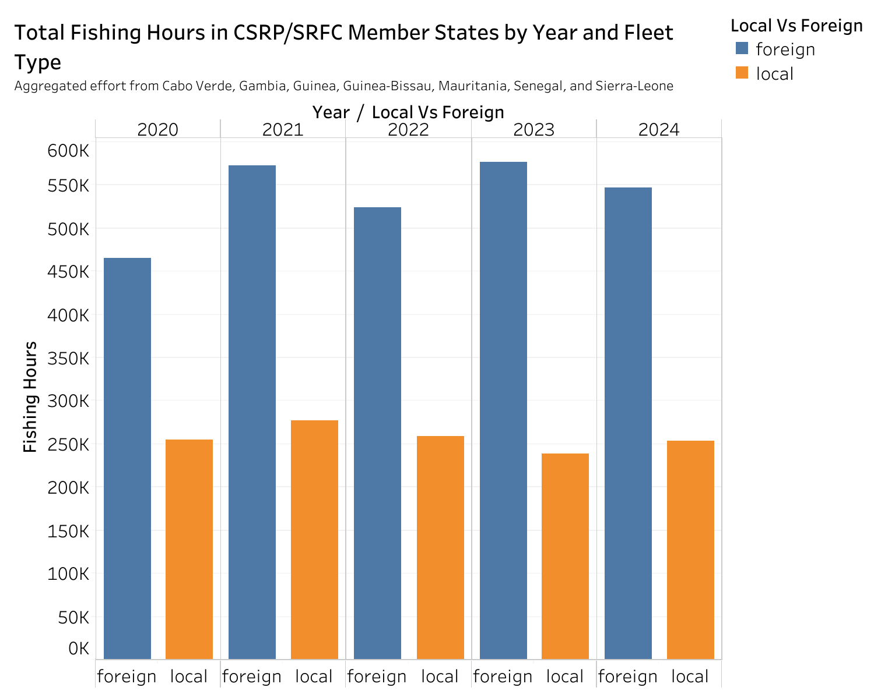
Definition: Local vessels are those flying the flag of a CSRP member state (CPV – Cabo Verde, MRT – Mauritania, SEN – Senegal, GMB – The Gambia, GNB – Guinea-Bissau, GIN – Guinea, and SLE – Sierra Leone). Any vessel with a flag different from these is classified as a foreign vessel.
Observation: Across all five years, fishing activity in the combined CSRP member states is predominantly carried out by foreign vessels—approximately twice as much as by local vessels.

Slide 5
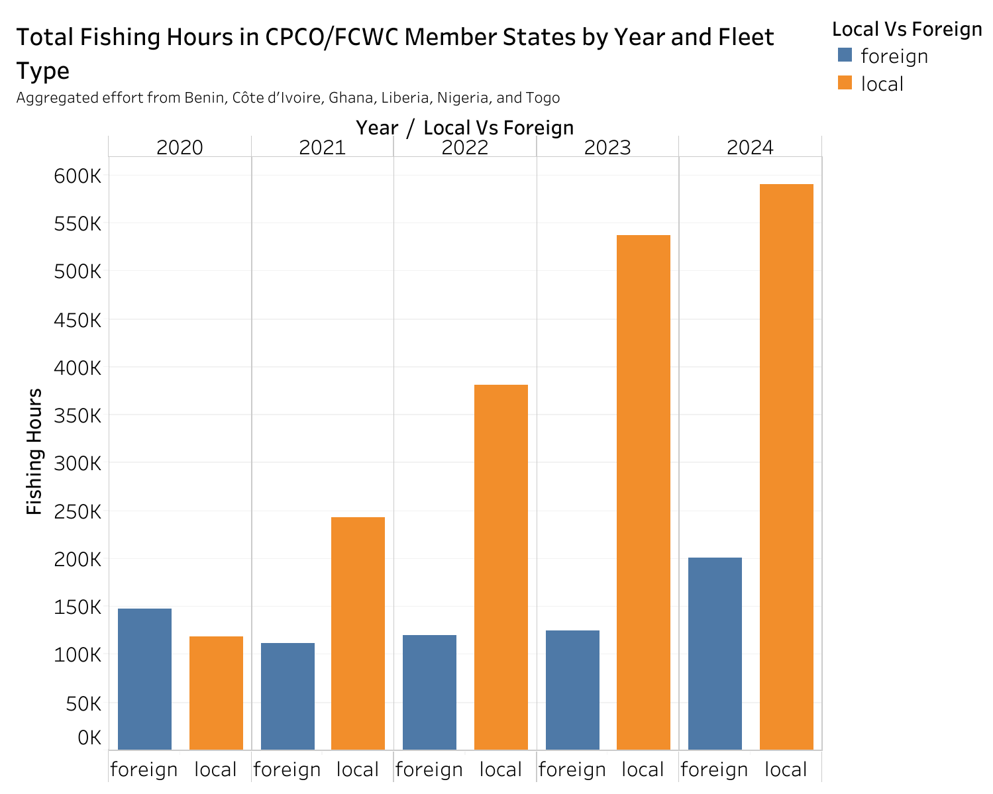
Definition: Local vessels are those flying the flag of a CPCO member state (BEN – Benin, CIV – Côte d’Ivoire, GHA – Ghana, LBR – Liberia, NGA – Nigeria, and TGO – Togo). Any vessel with a flag different from these is classified as a foreign vessel.
Observation: In all years except 2020, fishing activity in the combined CPCO member states is predominantly carried out by local vessels—about 2 to 4 times more than by foreign vessels.

Slide 6
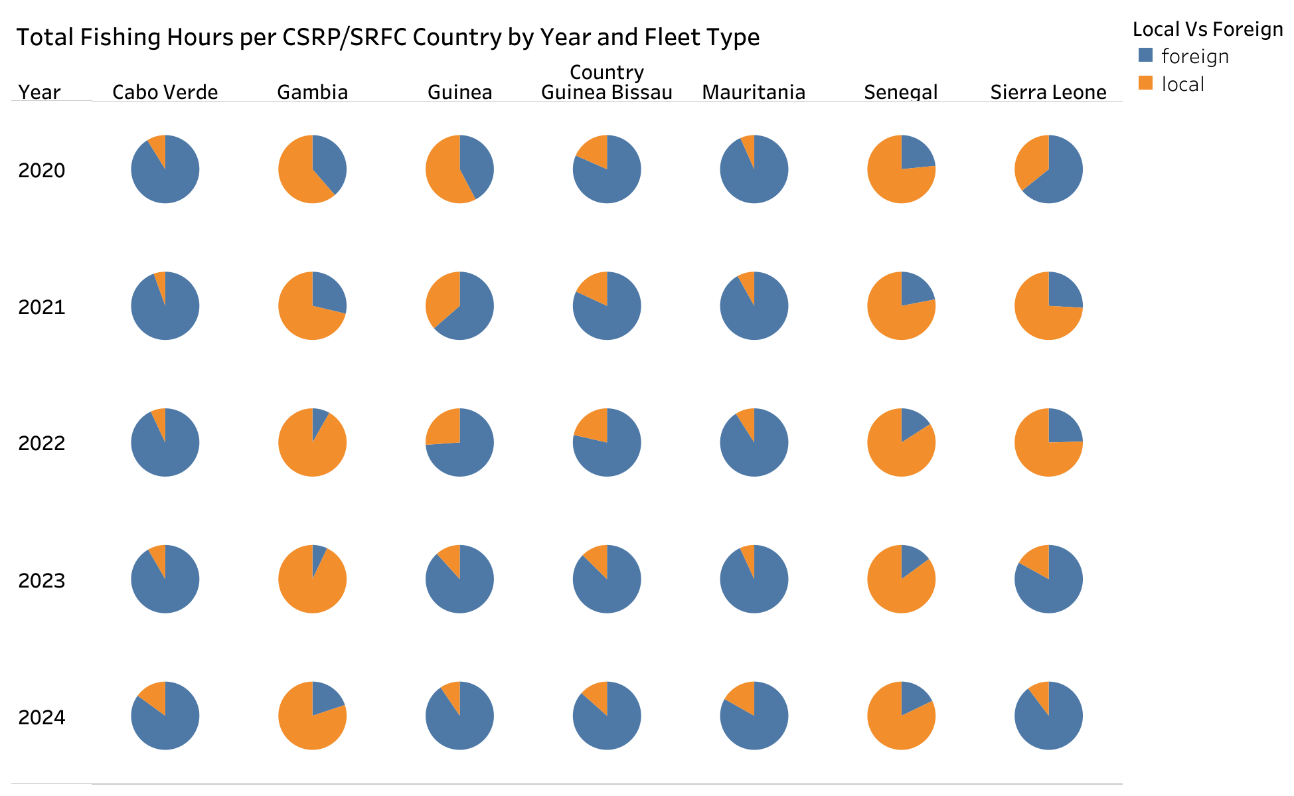
When examining fishing hours by member country:
Cabo Verde, Guinea-Bissau, and Mauritania: Foreign vessels account for the majority of fishing activity in all five years, while local vessels contribute less.
Gambia and Senegal: Local vessels account for the majority of fishing activity in all years, with foreign vessels contributing a smaller share.
Sierra Leone: The predominance shifts over time — foreign vessels lead in 2021 and 2022, while local vessels take the lead in 2023 and 2024.
Guinea: Foreign vessels dominate in all years except 2020.

Slide 7
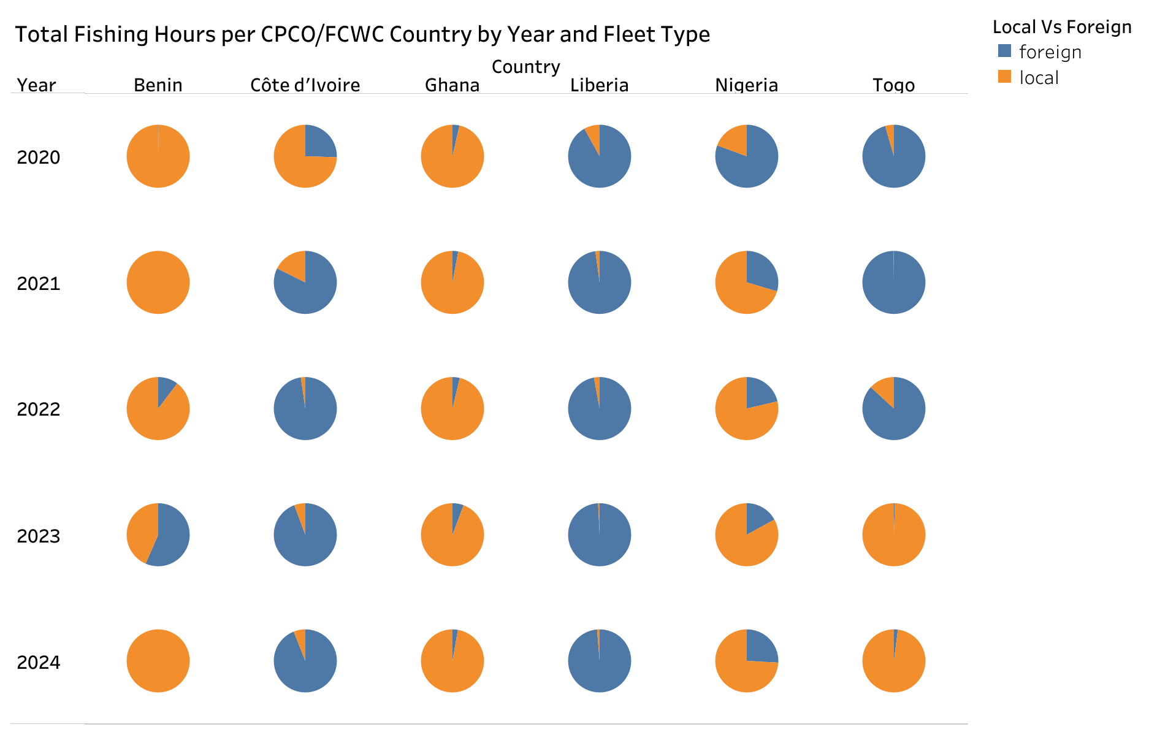
Liberia: Fishing activity is consistently dominated by foreign vessels across all five years, whereas in Ghana, local vessels are predominant.
Côte d’Ivoire: Foreign vessels dominate in all years except 2020, while in Nigeria, local vessels are mostly in the lead.
Benin: Local vessels predominate in all years except 2023.
Togo: The predominance shifts over time: foreign vessels are more active from 2020 to 2022, while local vessels take the lead in 2023 and 2024.

Slide 8
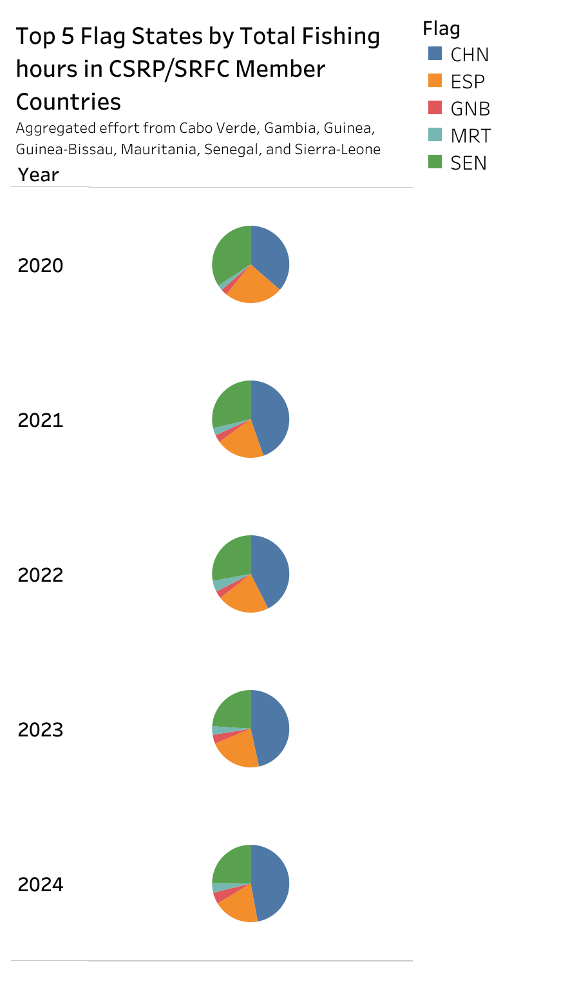
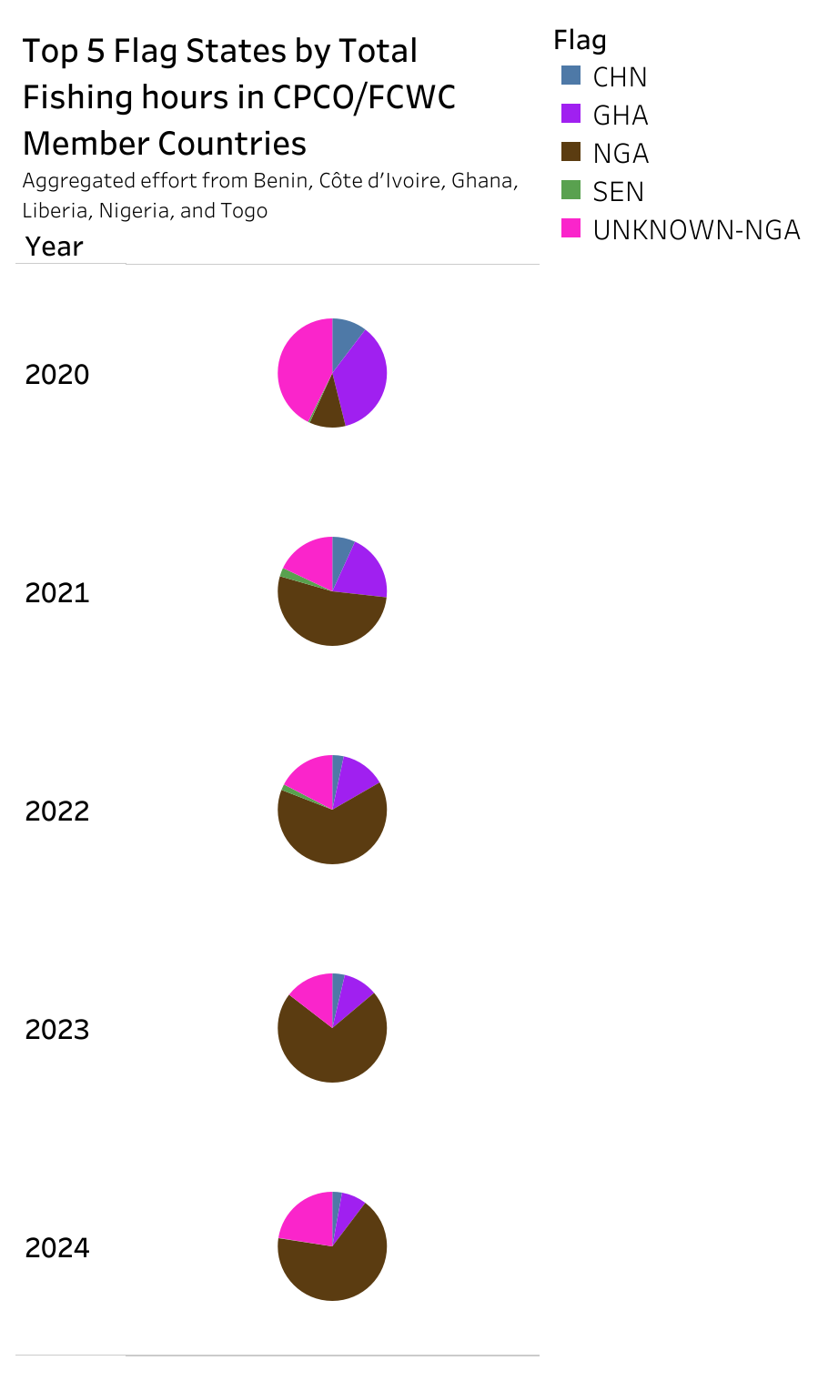
Combined CSRP member states: Fishing is mostly carried out by vessels flagged in China (CHN), Senegal (SEN), Spain (ESP), Mauritania (MRT), and Guinea-Bissau (GNB).
Combined CPCO member states: Fishing is mostly carried out by vessels flagged in Nigeria (NGA), UNKNOWN-NGA, Ghana (GHA), China (CHN), and Senegal (SEN).

Slide 9
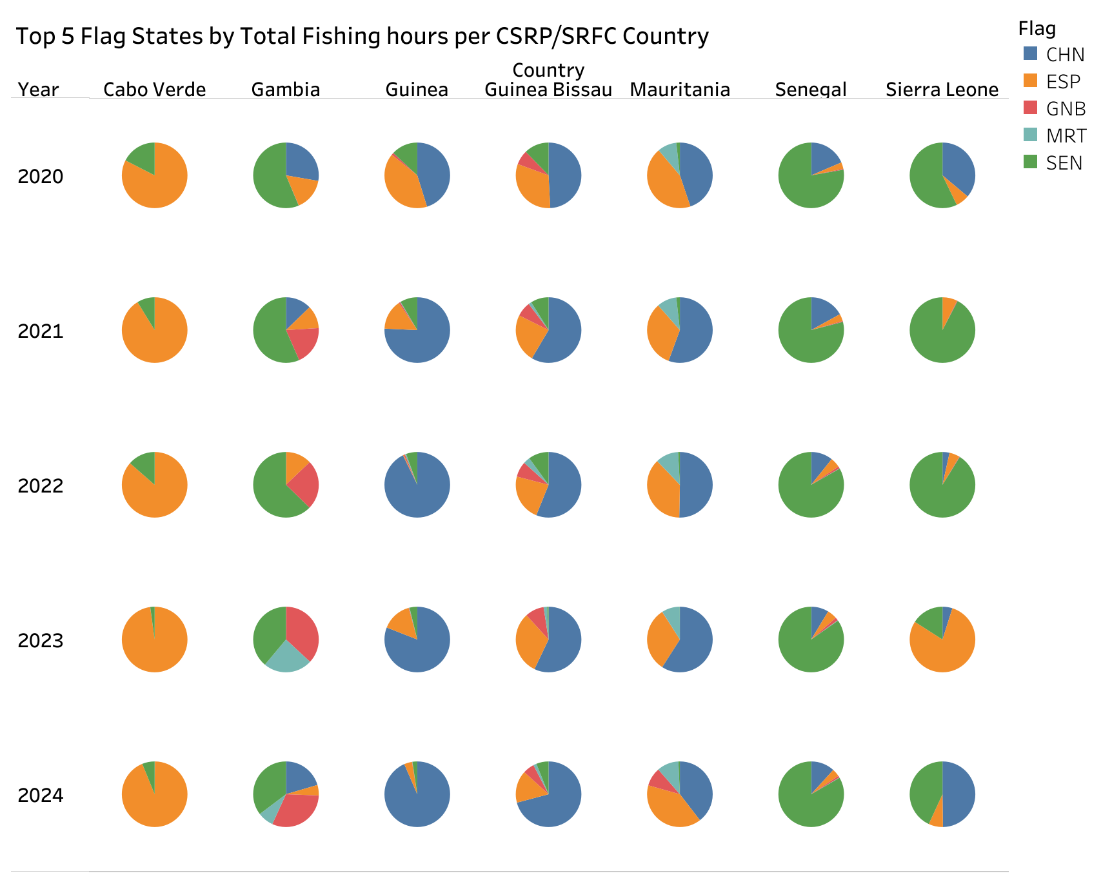
Cabo Verde: Fishing is mostly carried out by vessels flagged in Spain (ESP).
Senegal and Gambia: Fishing is mostly carried out by vessels flagged in Senegal (SEN).
Guinea and Guinea-Bissau: Fishing is mostly carried out by vessels flagged in China (CHN).
Mauritania: Fishing is mostly carried out by vessels flagged in China (CHN), except in 2024 when Spain (ESP) accounts for the highest fishing activity.
Sierra Leone: From 2020 to 2022, the flag of Senegal (SEN) predominates, while in 2023 and 2024, the flags of Spain (ESP) and China (CHN) predominate, respectively.

Slide 10
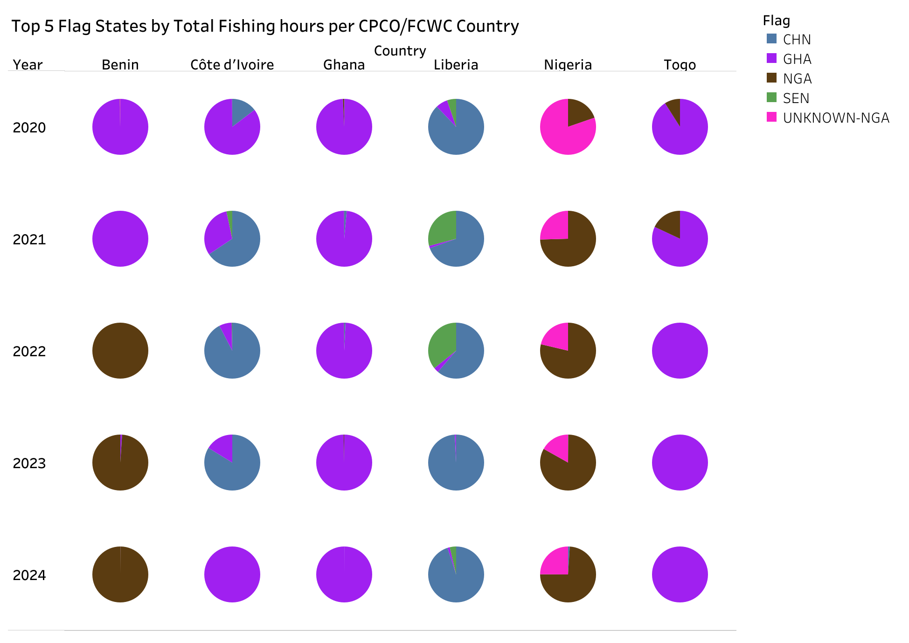
Ghana and Togo: Fishing is mostly carried out by vessels flagged in Ghana (GHA).
Liberia: The flag of China (CHN) predominates.
Nigeria: The flag of Nigeria (NGA) predominates, except in 2020 when UNKNOWN-NGA predominates.
Benin: From 2020 to 2021, the flag of Ghana (GHA) predominates, while from 2022 to 2024, the flag of Nigeria (NGA) predominates.
Côte d’Ivoire: From 2021 to 2023, the flag of China (CHN) predominates, while in 2020 and 2024, the flag of Ghana (GHA) predominates.

Slide 11
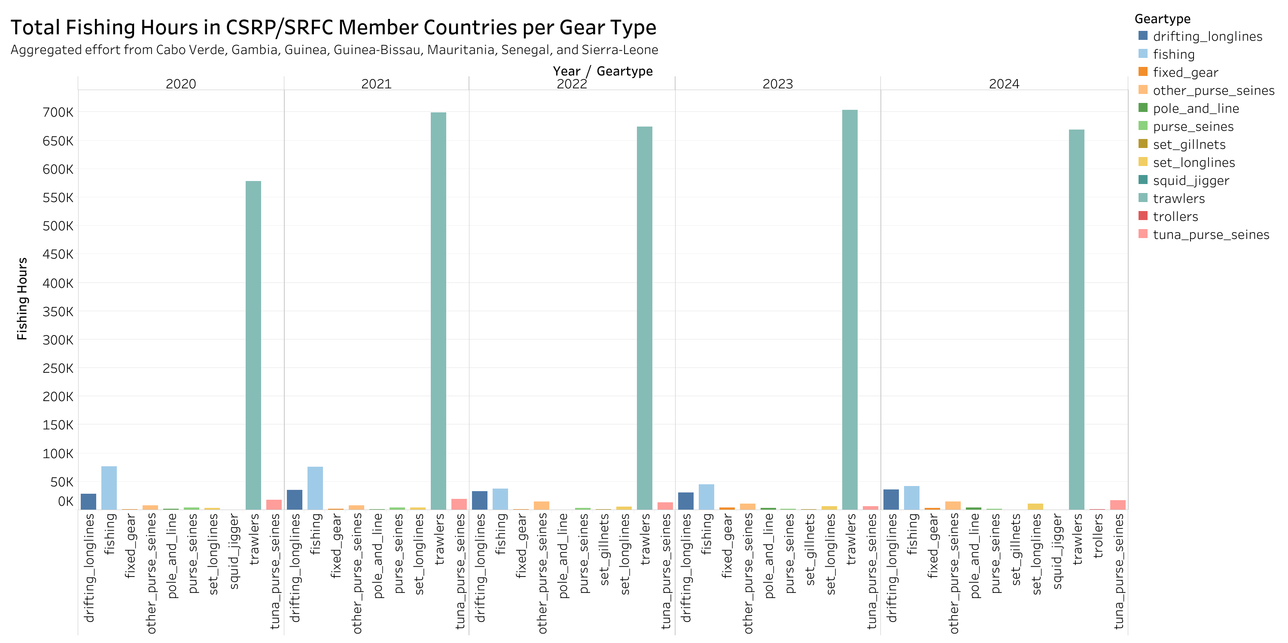
Combined CSRP member countries: Over the five-year period, trawlers were by far the most widely used fishing gear.

Slide 12
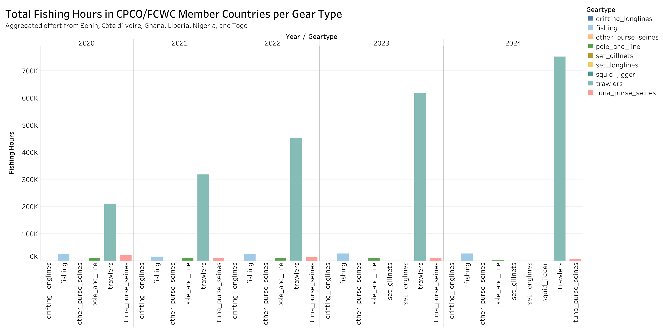
Combined CPCO member countries: Over the five-year period, trawlers were by far the most widely used fishing gear, with total fishing effort increasing over the years.

Slide 13
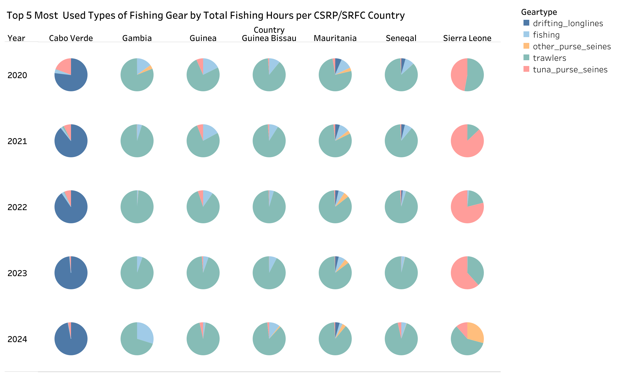
Gambia, Guinea, Guinea-Bissau, Mauritania, and Senegal: Over the five-year period, trawlers were by far the most widely used fishing gear.
Cabo Verde: Over the five-year period, drifting longlines were by far the most widely used fishing gear.
Sierra Leone: From 2021 to 2023, tuna purse seines were the most used fishing gear, while in 2020 and 2024, trawlers predominated.

Slide 14
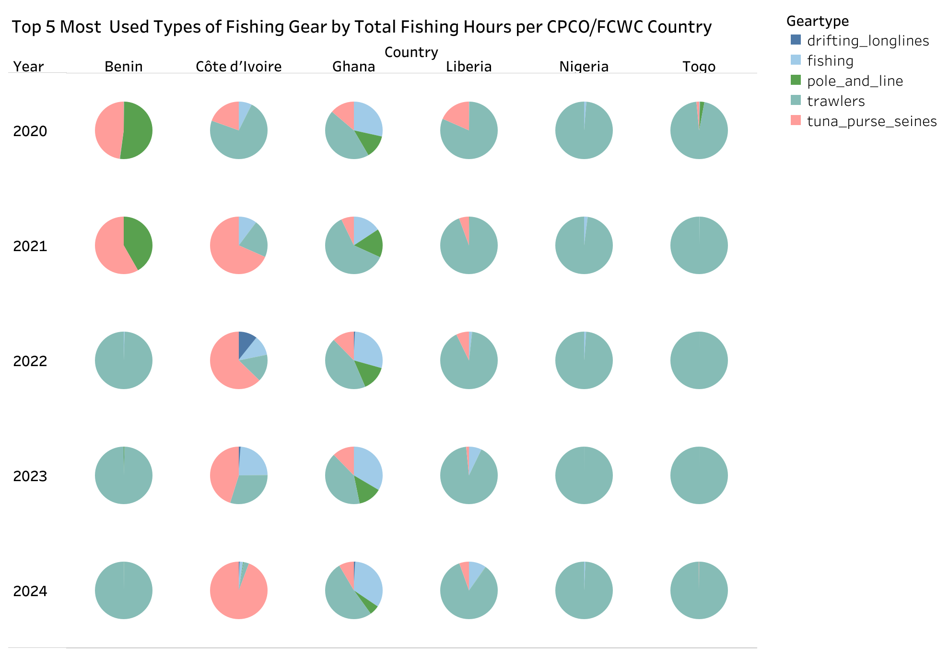
Nigeria, Togo, Liberia, and Ghana: Over the five-year period, trawlers were the most used fishing gear.
Côte d’Ivoire: Tuna purse seines were the most used fishing gear, except in 2020 when trawlers predominated.
Benin: In 2020, pole and line were the most used fishing gear, in 2021 tuna purse seines predominated, and from 2022 to 2024, trawlers were by far the most widely used fishing gear.

Slide 15
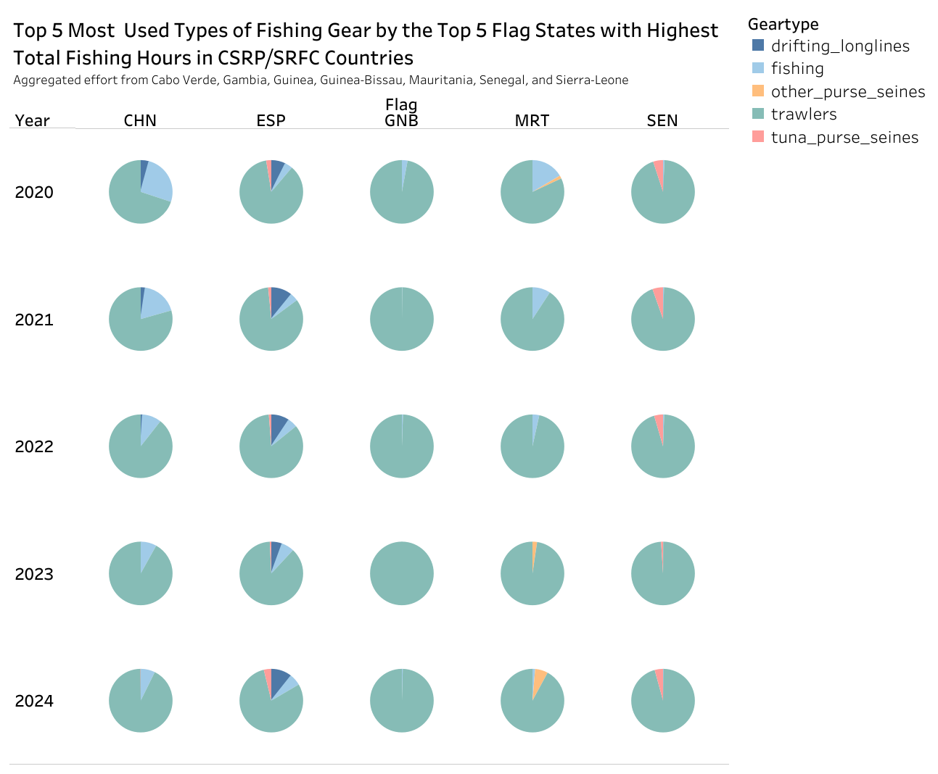
Top five flag states in the CSRP area: China (CHN), Spain (ESP), Guinea-Bissau (GNB), Mauritania (MRT), and Senegal (SEN) mainly used trawlers as fishing gear over the five-year period.

Slide 16
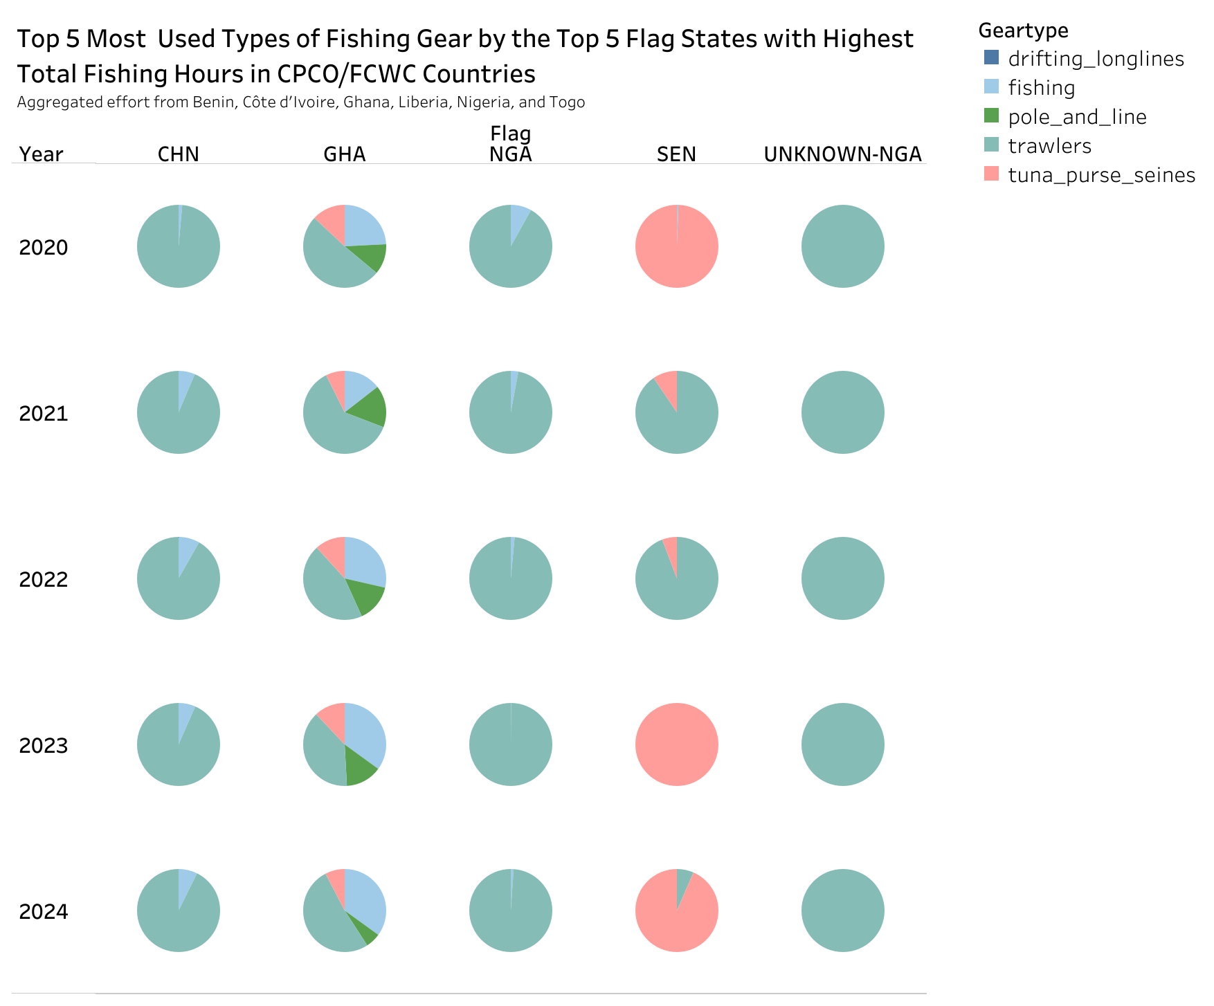
Top five flag states in the CPCO area: Four flags—China (CHN), Ghana (GHA), Nigeria (NGA), and UNKNOWN-NGA—mainly used trawlers as fishing gear over the five-year period. The remaining flag, Senegal (SEN), mainly used trawlers from 2021 to 2022, while in 2020, 2023, and 2024, tuna purse seines were most used.

Slide 17
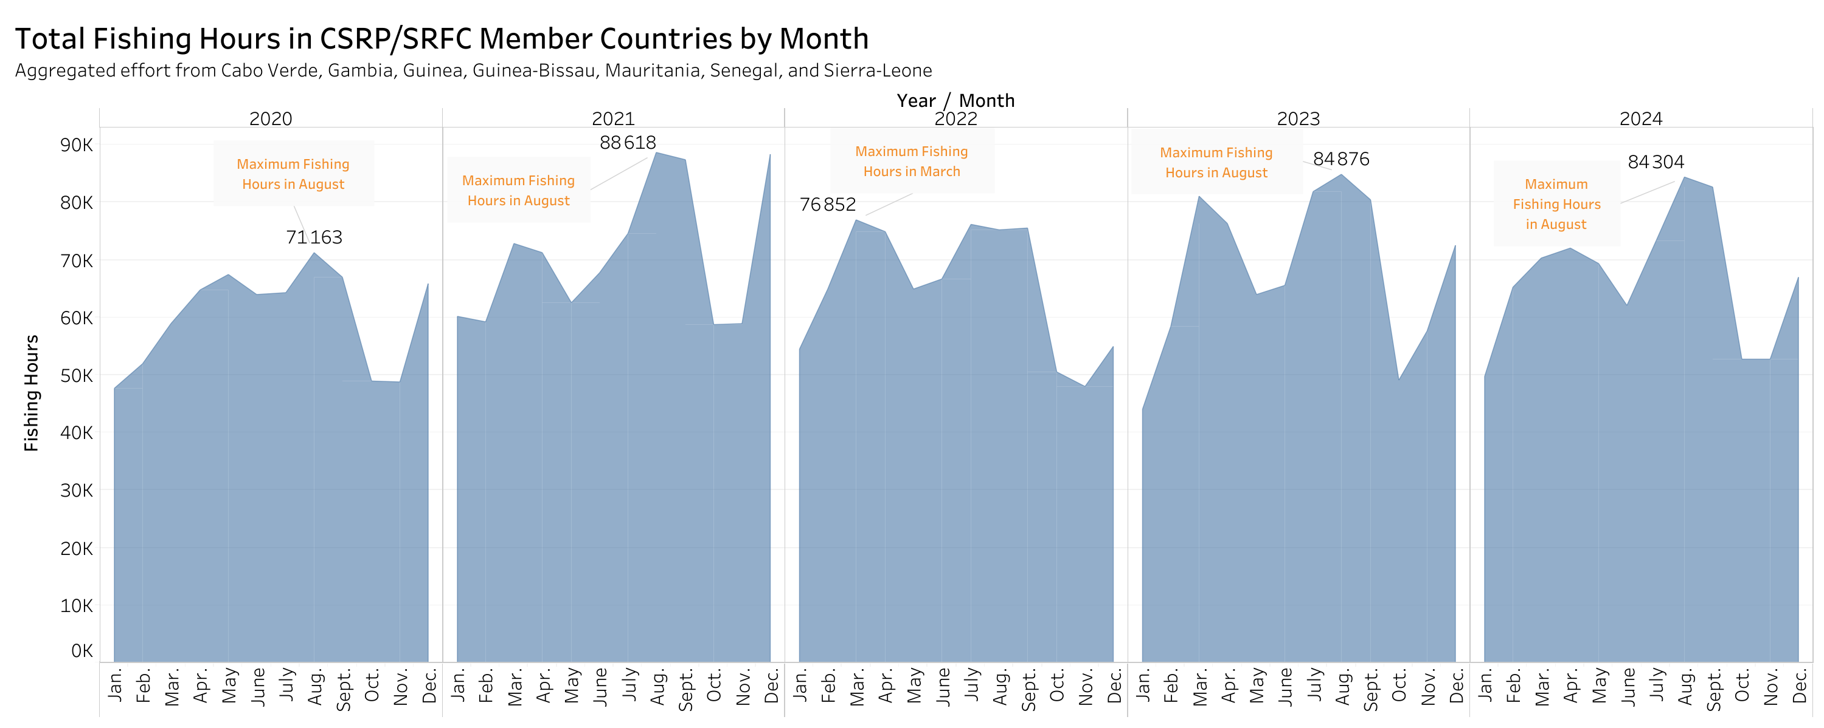
CSRP area (2020–2024): Among the months, August was often associated with the highest fishing activity.

Slide 18
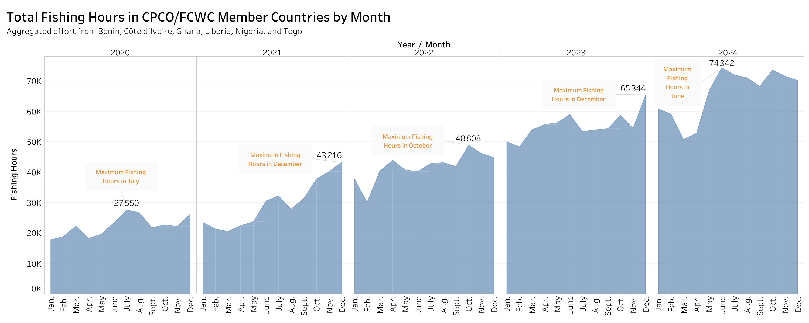
CPCO area (2020–2024): The month with the highest fishing activity generally fell between June and December.

Slide 19
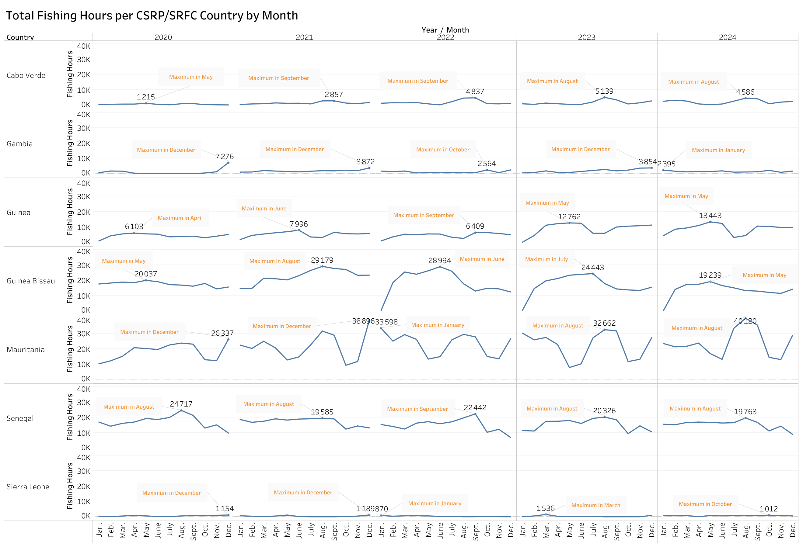
CSRP member countries (2020–2024): In each country, the month with the highest fishing activity varied across the different years, except in Senegal, where it was almost always August.

Slide 20
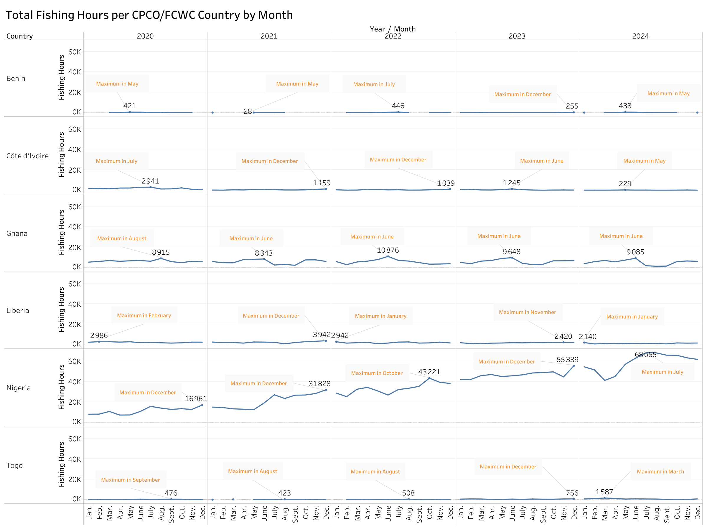
CPCO member countries (2020–2024): In each country, the month with the highest fishing activity varied across the different years, except in Ghana, where it was almost always June.

Slide 21
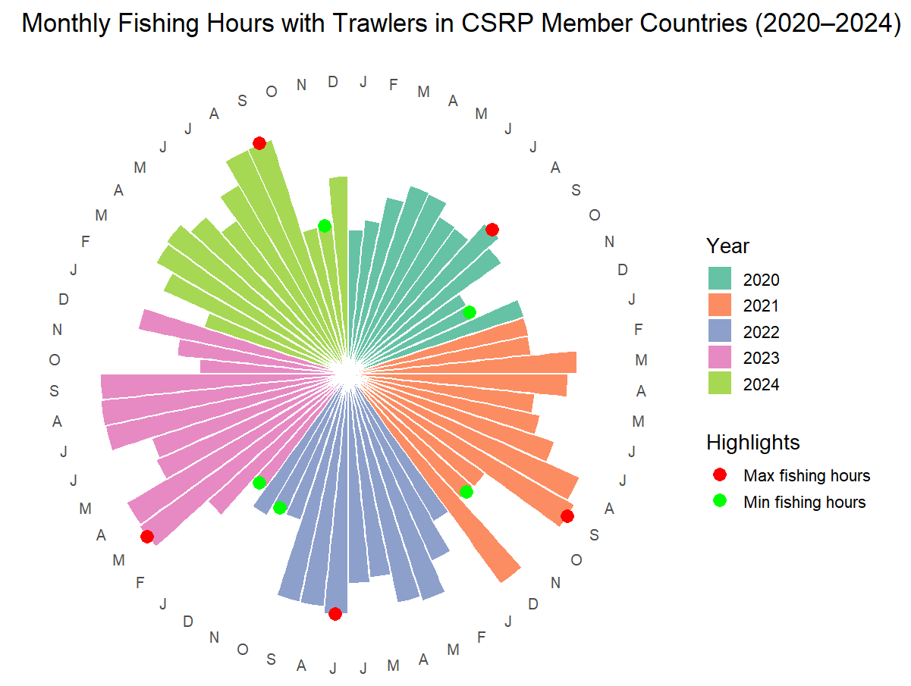
CSRP member countries combined (2020–2024): The maximum trawler fishing activity generally occurred between July and September, except in 2020 when it was March. Within this interval, September most frequently recorded the highest trawler fishing hours.
Conversely, November usually had the lowest trawler fishing hours, except in 2023 when January recorded the minimum.

Slide 22
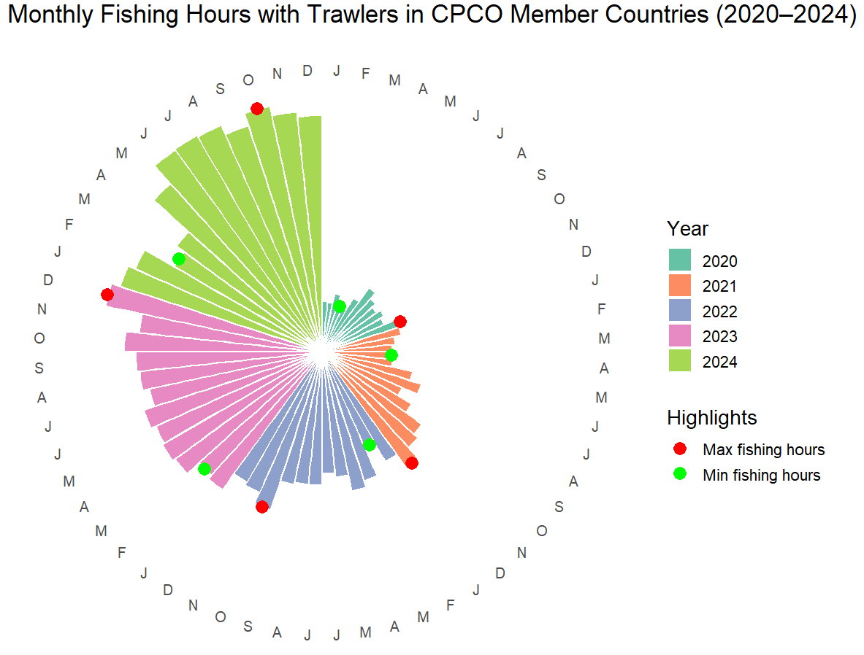
CPCO member countries combined (2020–2024): The highest trawler fishing hours occurred in either October or December.
Conversely, the lowest trawler fishing hours generally fell between February and March.

Slide 23
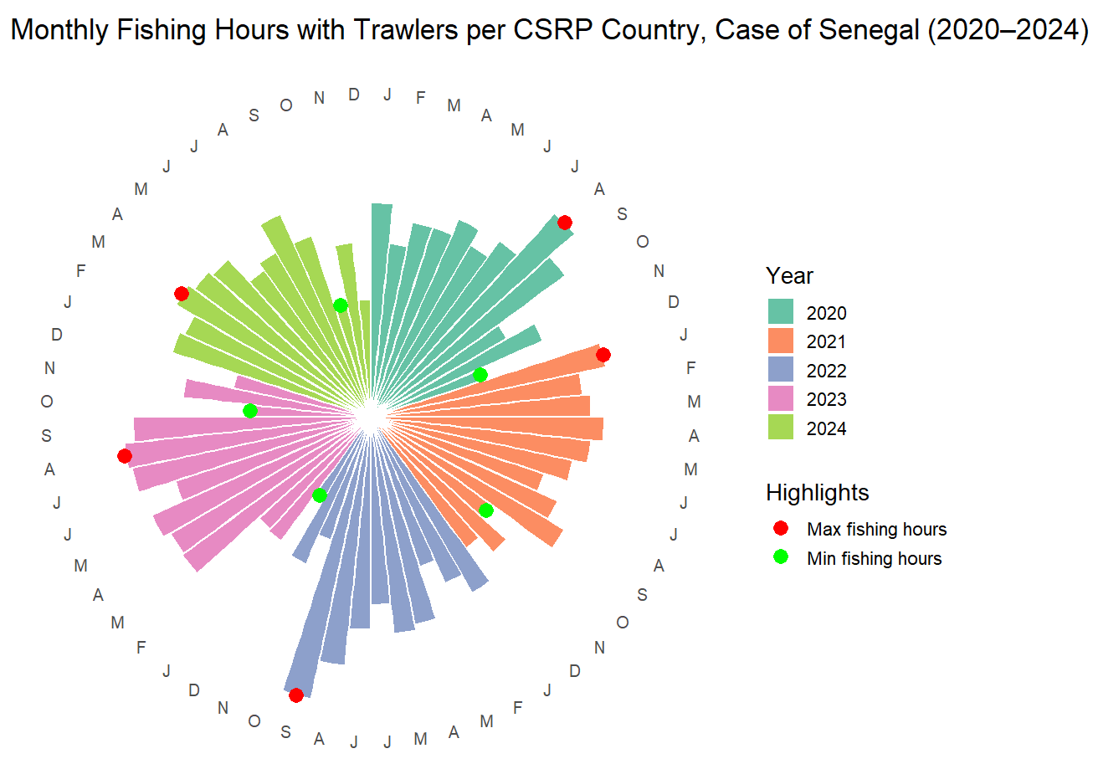
Senegal (2020–2024): The month with the highest trawler fishing hours varied from year to year, with August occurring most frequently. In 2024, the peak month was March.
Conversely, the lowest trawler fishing hours generally occurred in either October or December.

Slide 24
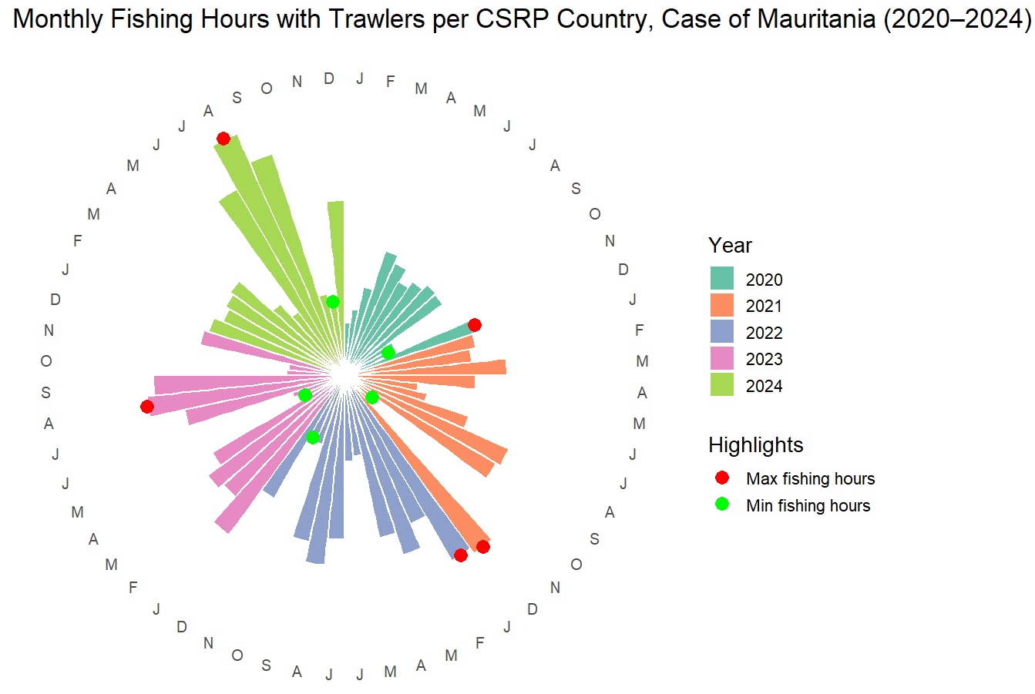
Mauritania (2020–2024): The highest trawler fishing hours occurred in December or January from 2020 to 2022, and in August during 2023 and 2024.
Conversely, November generally recorded the lowest trawler fishing hours, except in 2023 when May had the minimum.

Slide 25
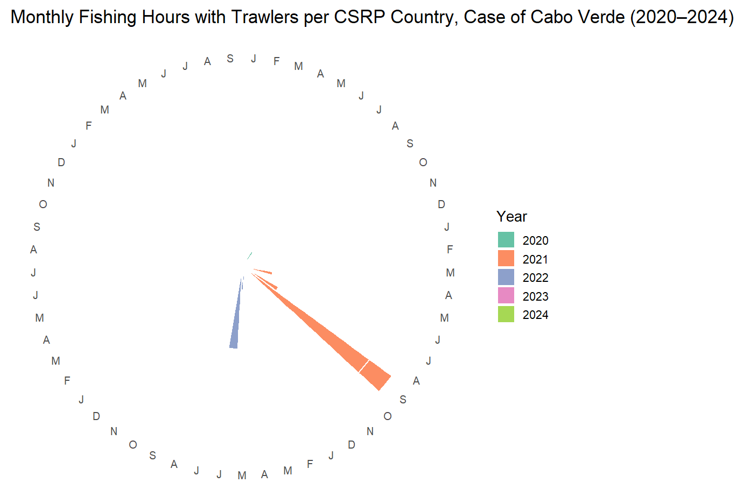
Cabo Verde (2020–2024): Compared to other CSRP countries, fishing with trawlers occurred during very few months, with the majority of months recording zero fishing hours with trawlers. As noted earlier, drifting longlines were by far the most widely used fishing gear.

Slide 26
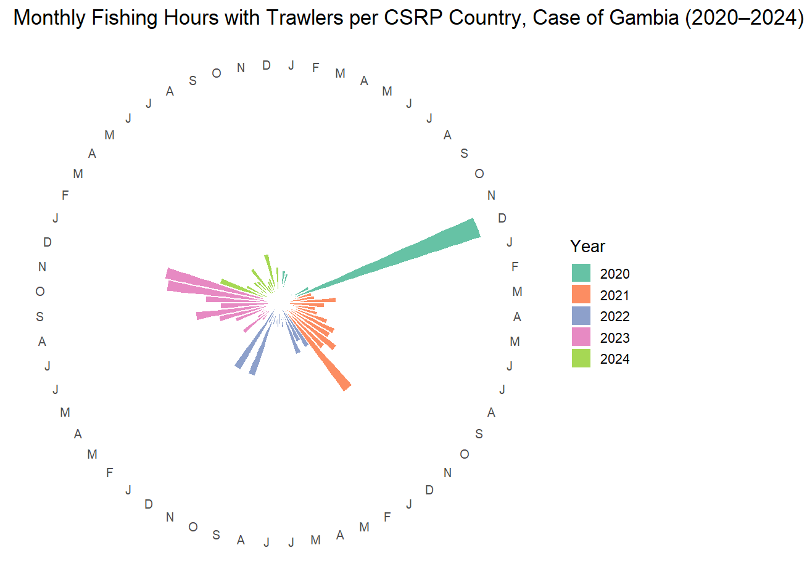
Gambia (2020–2024): The highest trawler fishing hours occurred in October, December, or January.

Slide 27
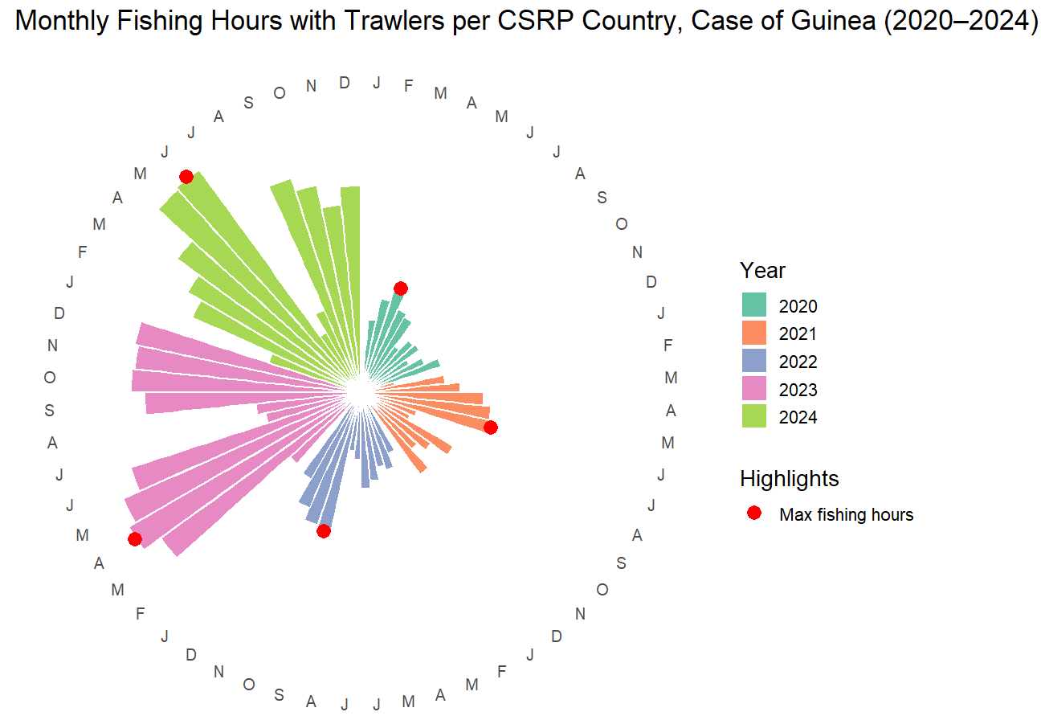
Guinea (2020–2024): The highest trawler fishing hours occurred between April and August, with April and June appearing most frequently.

Slide 28
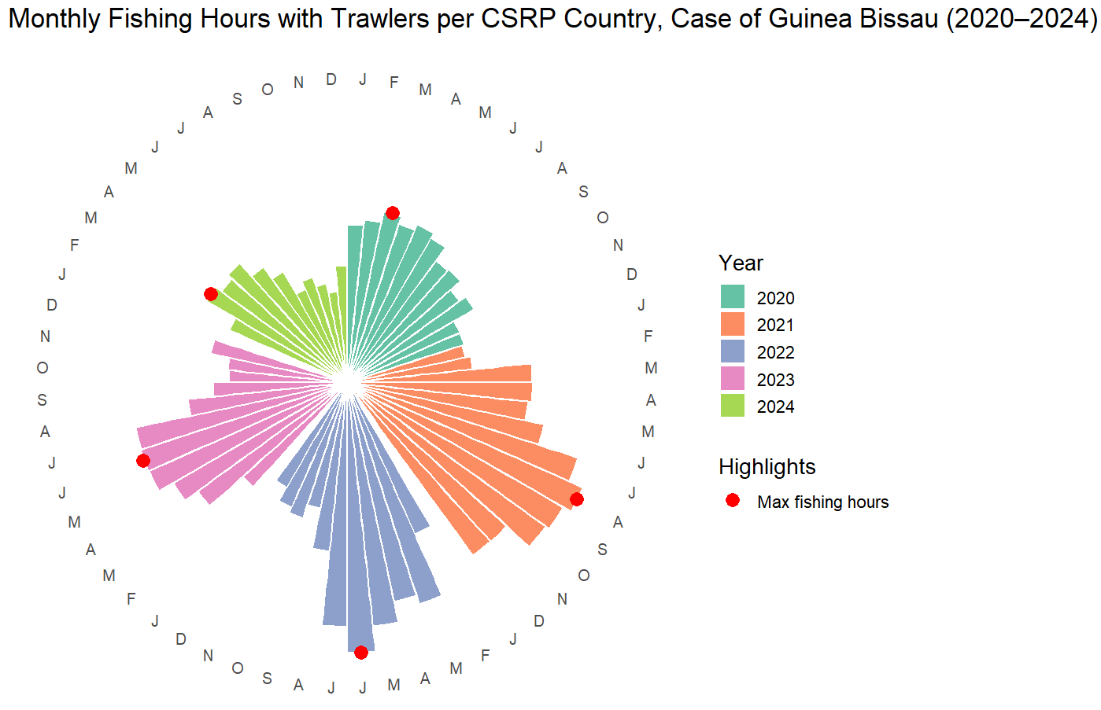
Guinea Bissau (2020–2024): The highest trawler fishing hours occurred between March and August, with March and June most frequently recording the maximum trawler fishing hours.

Slide 29
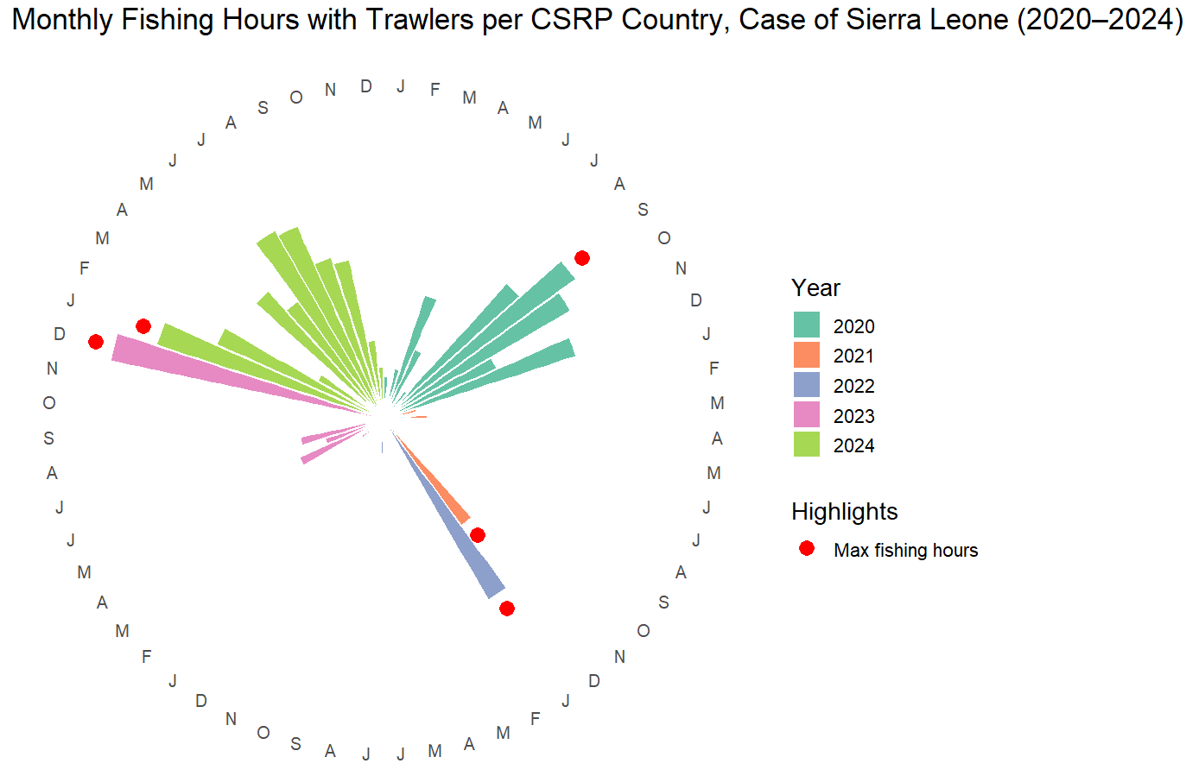
Sierra Leone (2020–2024): The highest trawler fishing hours generally occurred in December or January, except in 2020 when it was September.

Slide 30
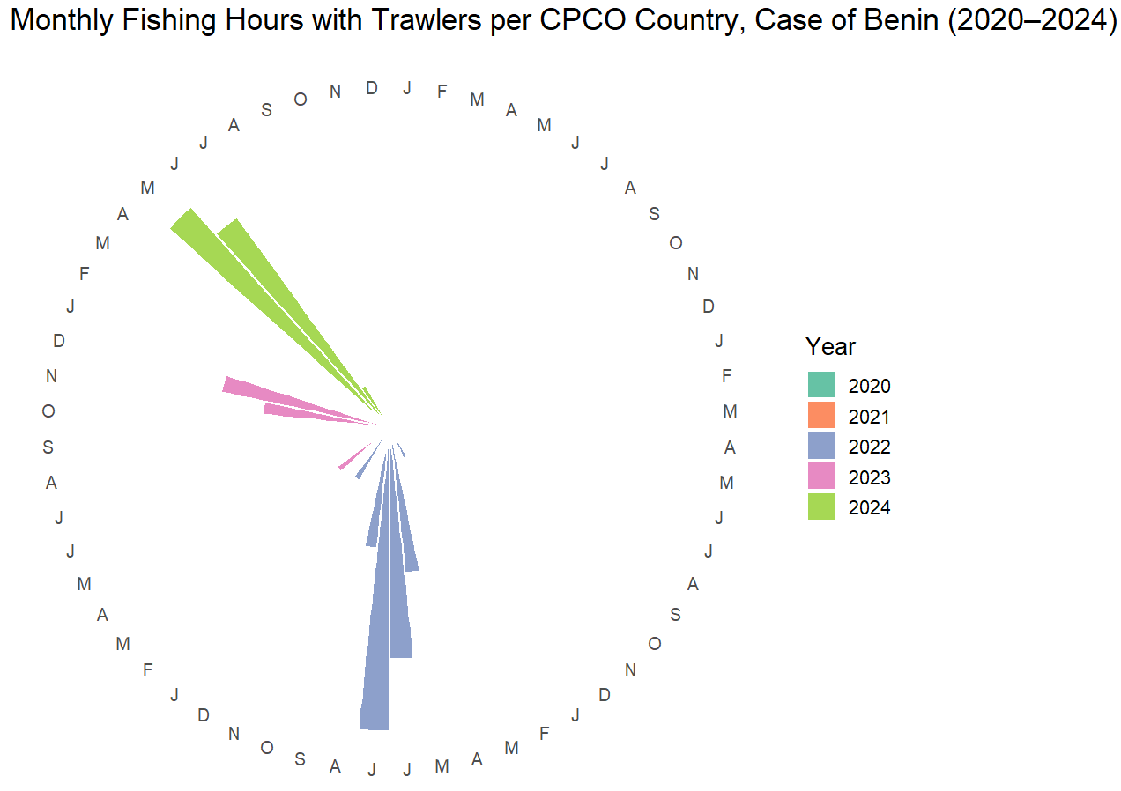
Benin (2020–2024): Fishing with trawlers occurred during very few months, with the majority of months recording zero fishing hours with trawlers.

Slide 31
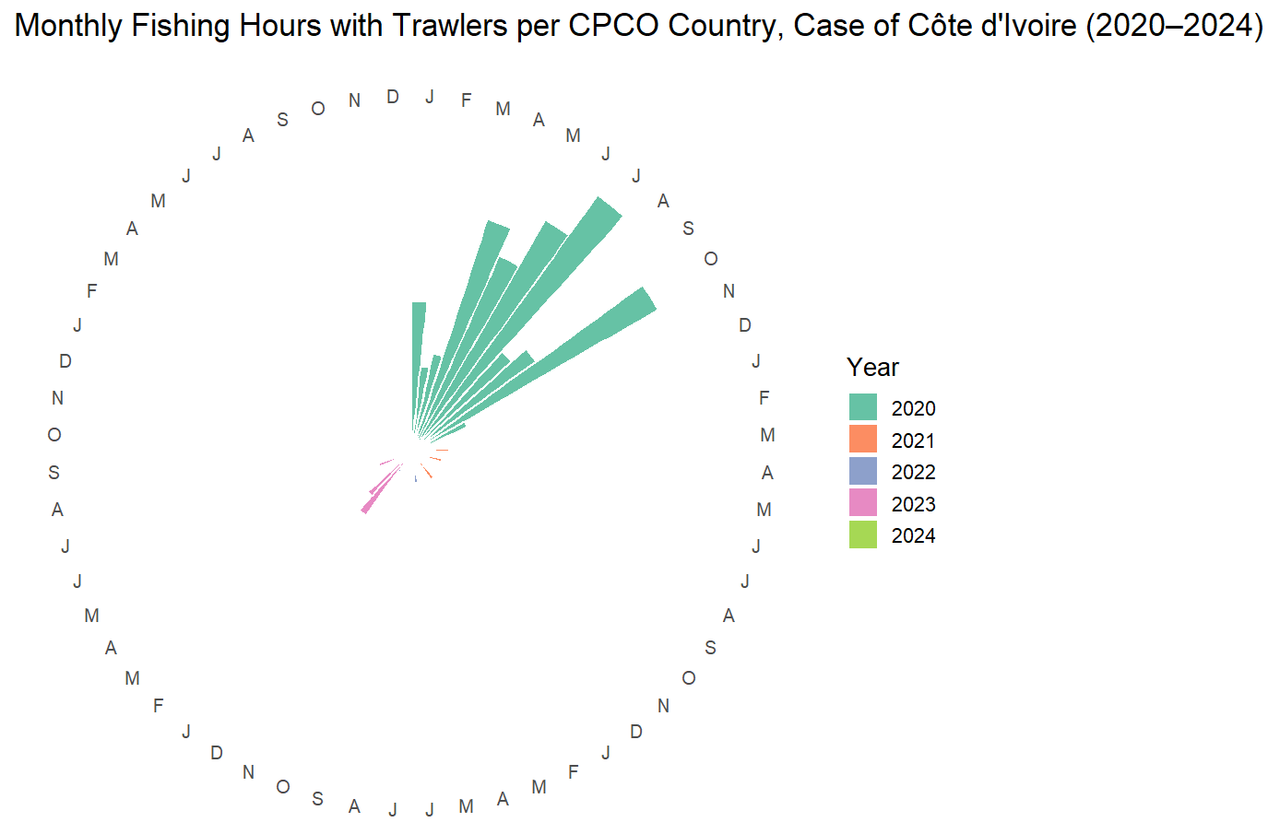
Côte d’Ivoire (2020–2024): Fishing with trawlers occurred during very few months, with the majority of months recording zero fishing hours with trawlers, except in 2020.

Slide 32
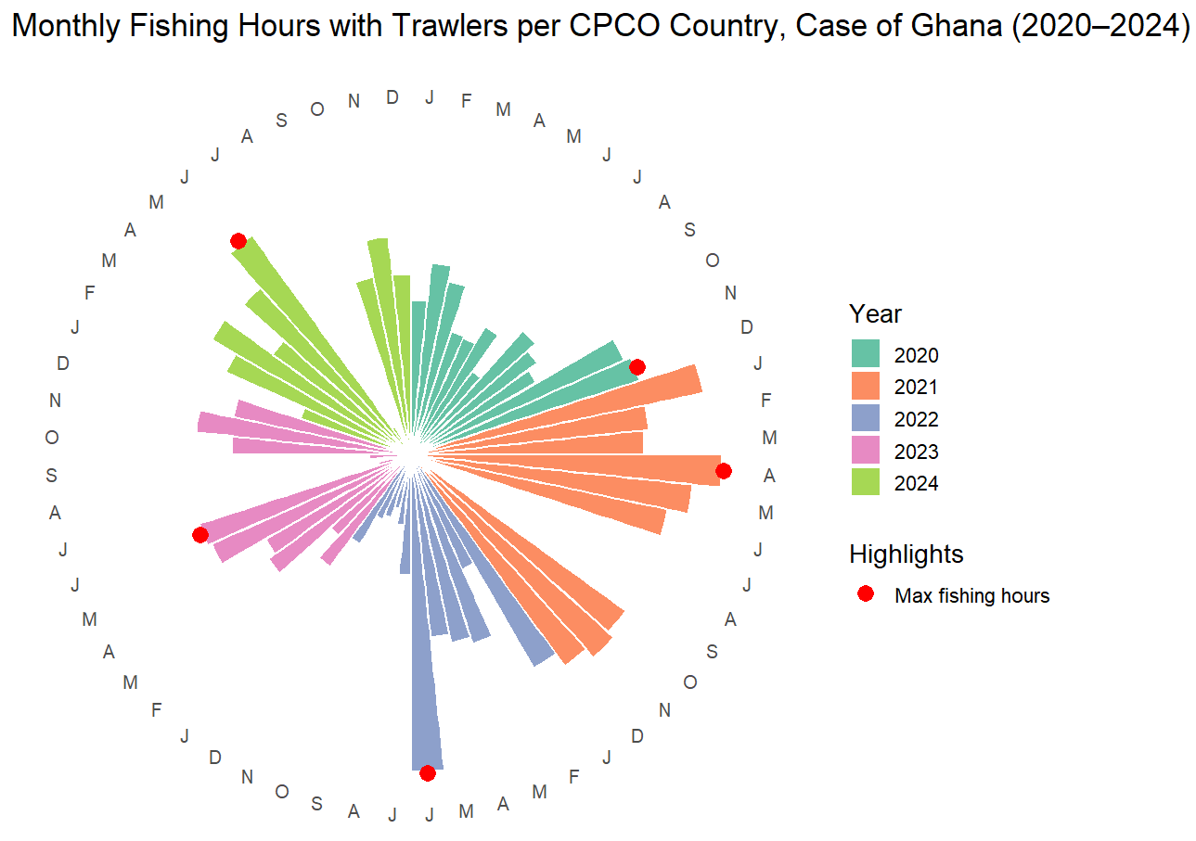
Ghana (2020–2024): The highest trawler fishing hours occurred in December in 2020 and April in 2021. For the remaining years, June consistently recorded the maximum trawler fishing hours.

Slide 33
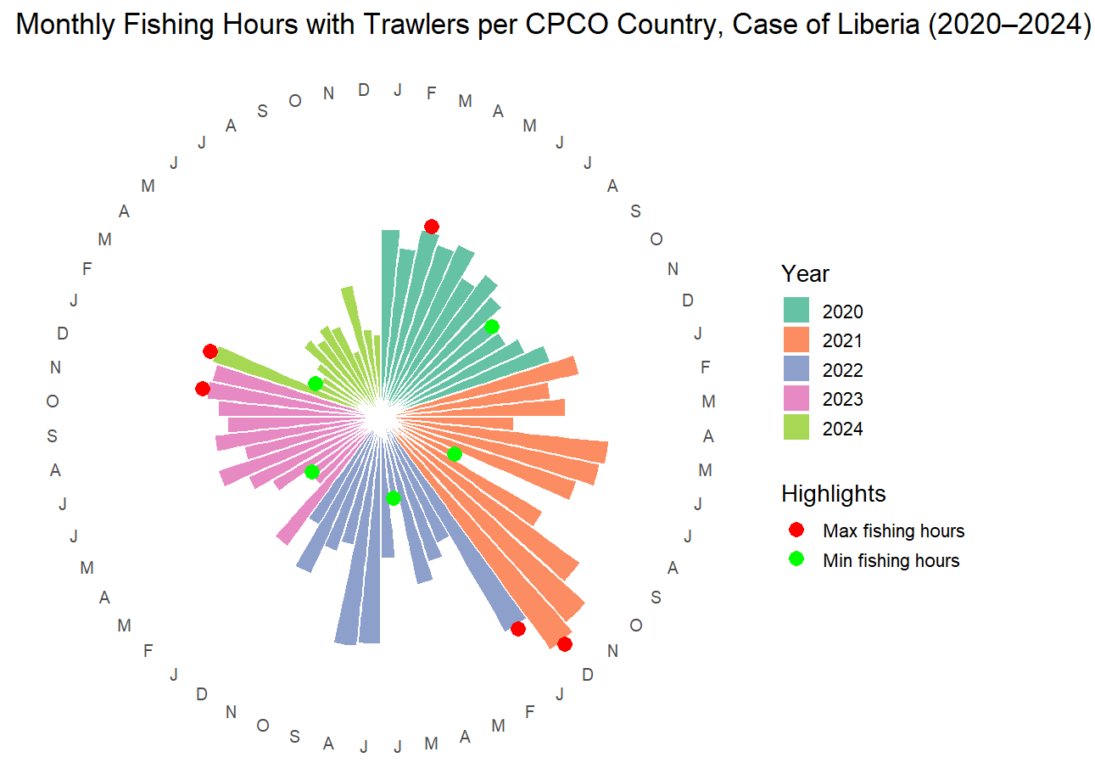
Liberia (2020–2024): The highest trawler fishing hours occurred between November and January, except in 2020 when it was March.
The lowest trawler fishing hours fell between May and September from 2020 to 2022, and in March and February for 2023 and 2024, respectively.

Slide 34
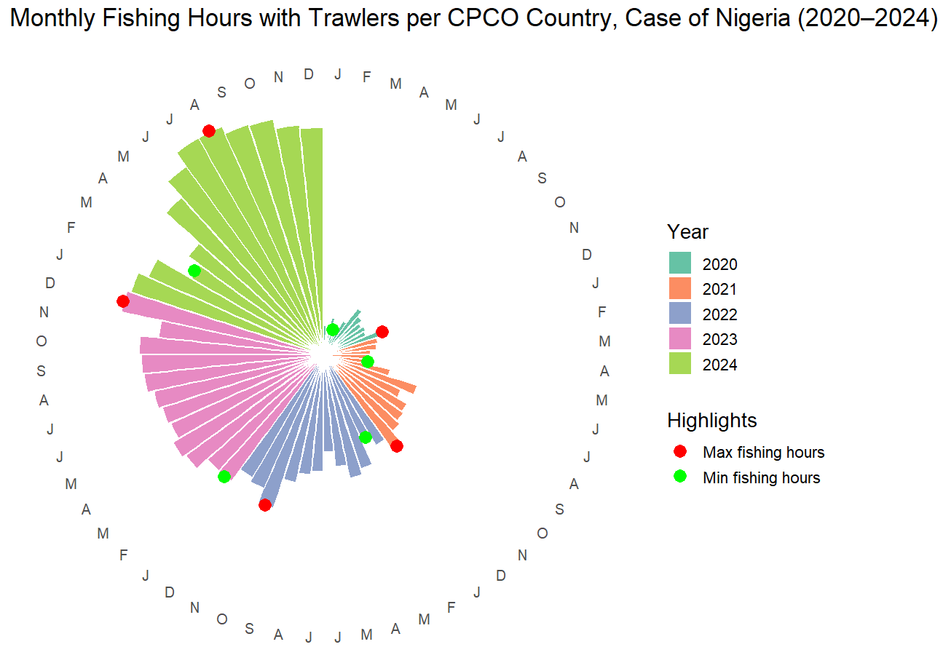
Nigeria (2020–2024): From 2020 to 2023, the highest trawler fishing hours occurred between October and December, with December appearing most frequently. In 2024, the peak month was August.
The month associated with lowest trawler fishing hours varied over the five-year period, mostly falling between January and March.

Slide 35
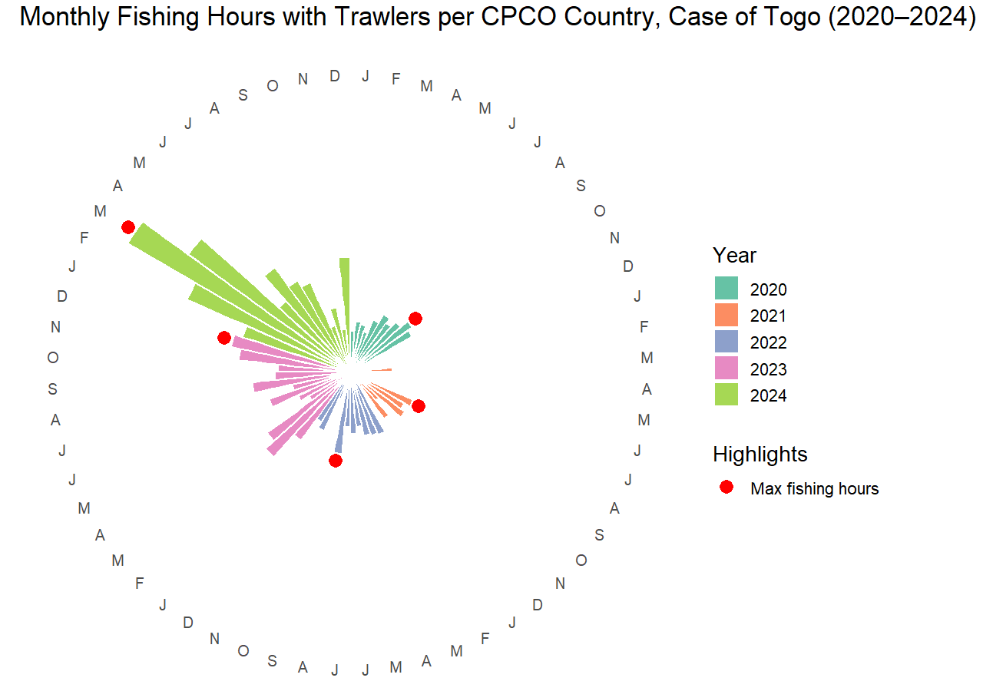
Togo (2020–2024): The month associated with highest trawler fishing hours varied between August and December from 2020 to 2023, and in 2024 the peak month was March.

Slide 36
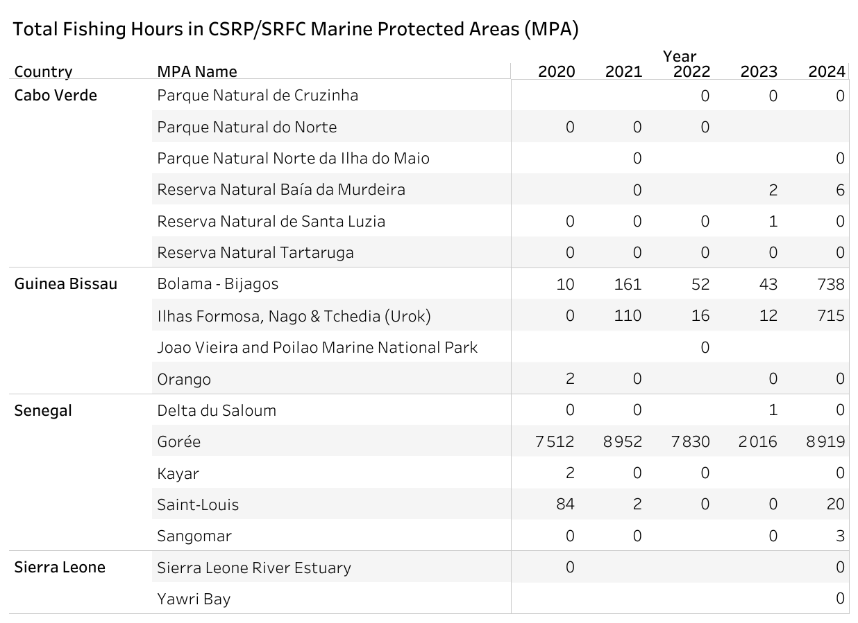
The table presents MPAs within the area covered by CSRP that have recorded data in the Global Fishing Watch dataset. Some MPAs have point coordinates appearing in the dataset but are associated with zero fishing hours. The MPAs with the highest fishing hours are Gorée in Senegal, followed by Bolama–Bijagos and Ilhas Formosa, Nago & Tchedia (Urok) in Guinea Bissau. Among CSRP member countries, MPAs in Mauritania, Gambia, and Guinea have no recorded data in the Global Fishing Watch dataset, corresponding to zero fishing hours.

Slide 37
Total Fishing Hours in CPCO/FCWC Marine Protected Areas (MPA)
There are no recorded data in the Global Fishing Watch dataset for MPAs within the area covered by CPCO, resulting in zero fishing hours. MPAs in Côte d’Ivoire, Liberia, and Nigeria show zero fishing activity. For Benin, Ghana, and Togo, no MPAs are listed in the World Database on Protected Areas from the Protected Planet website.

